Slide 1
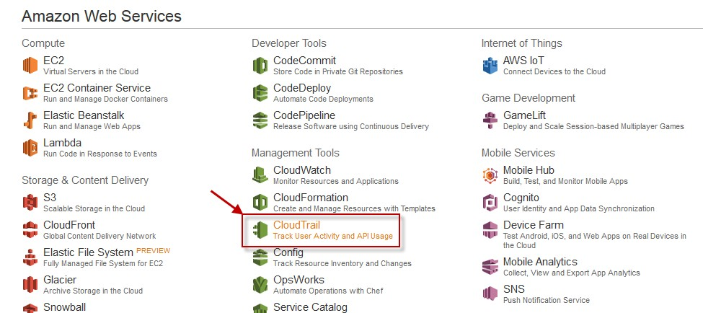
30. AWS CLOUDTRAIL
AWS CloudTrail used to get a history of AWS API calls and related events for your account. This includes calls made by using the AWS Management Console, AWS SDKs, command line tools, and higher-level AWS services.
You can identify which users and accounts called AWS for services that support CloudTrail, the source IP address the calls were made from, and when the calls occurred.
From the AWS management console choose CloudTrail under Management Tools.
Choose get started Now from CloudTrail landing page.

Slide 2
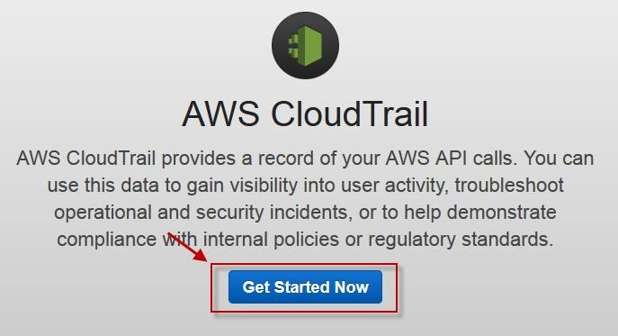
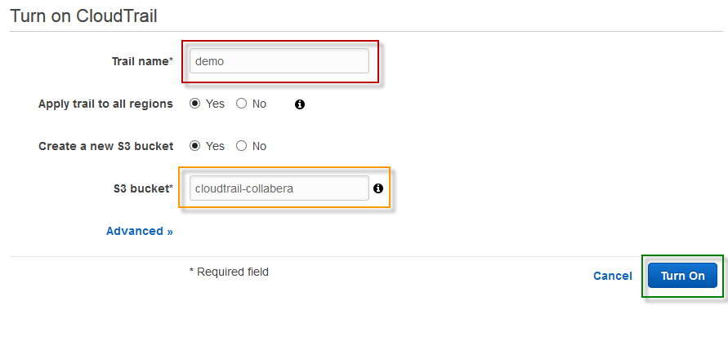
On the next page, specify a name for cloudtrail, specify a S3 bucket name or choose an existing one, then choose Turn On.
Once created you will be able to see the Trail under Trails tab.

Slide 3
